Slide 1
Machine Learning
Homework week 1: Introduction

Slide 2
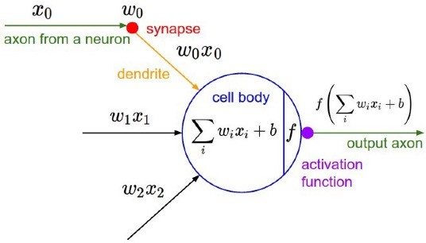
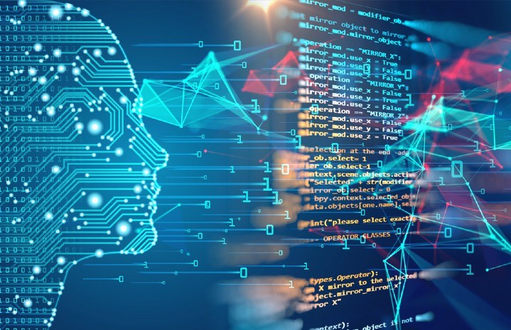
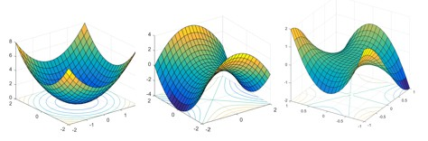
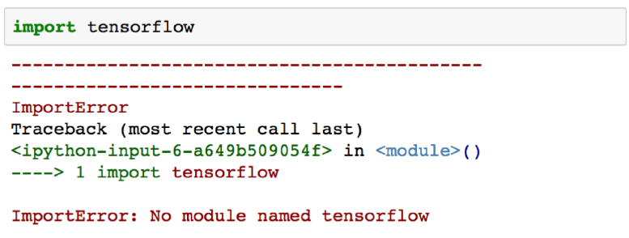
What do you learn from this course?
Concepts, tools, and intuition you need to implement programs capable of
learning from data
From simple techniques such as linear regression to some of deep learning techniques
A hands-on approach with just a little bit of theory to use production-ready Python frameworks
Public perception of ML
Reality

Slide 3
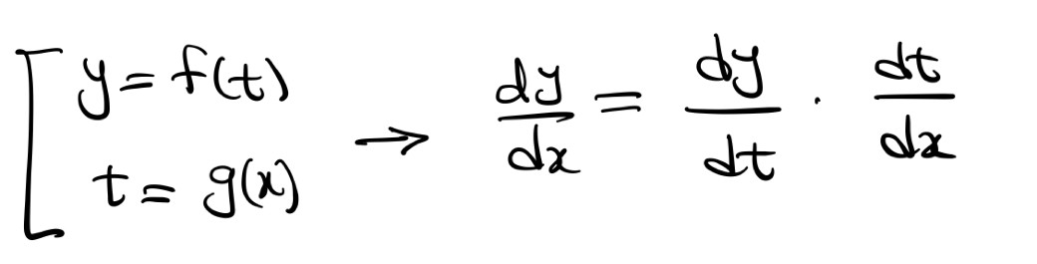
Course prerequisites
We need some level of calculus and linear algebra
  Vector, matrix, inner product, matrix-matrix multiplication
  Derivatives of polynomials and exponential functions
  Chain rule for finding the derivative of a composite function
Basics of probability and statistics
  Probability distributions (normal distribution, Bernoulli distribution, etc.)
  Mean, standard deviation, …

Slide 4
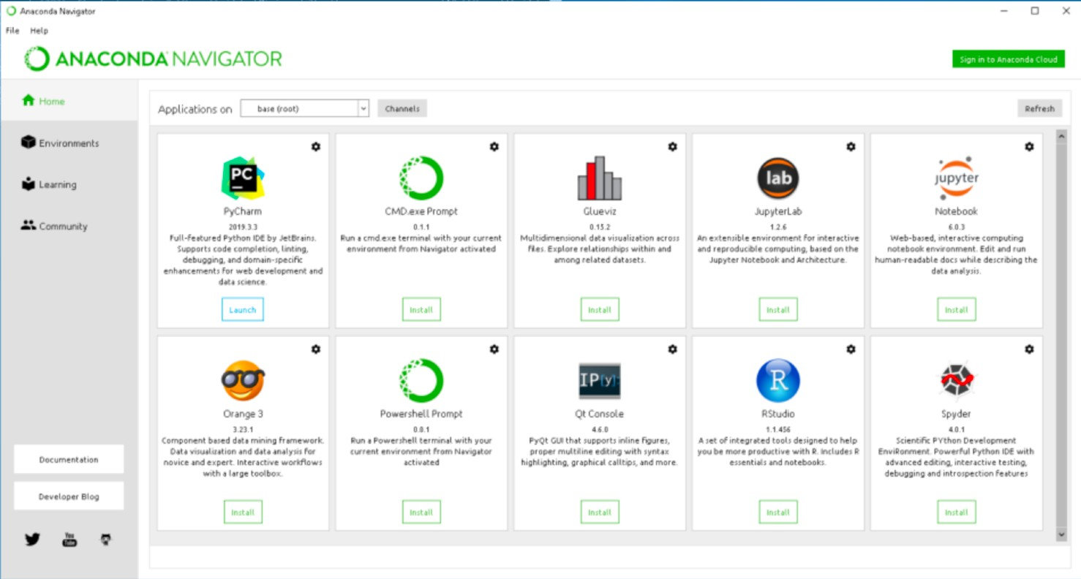
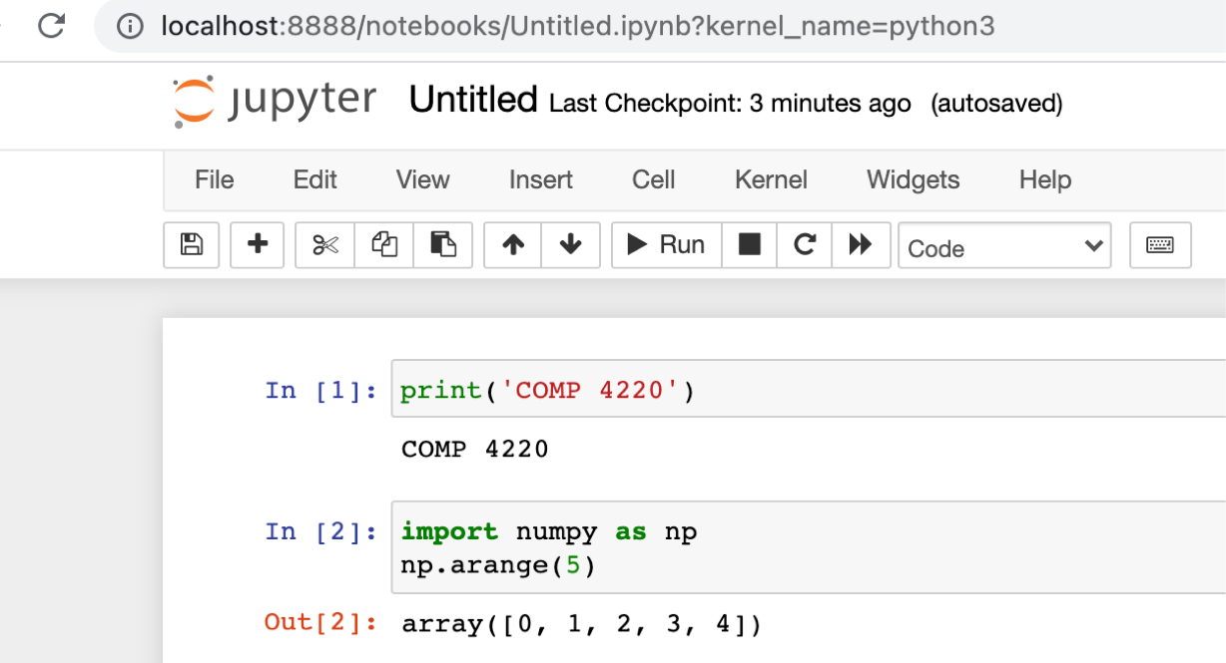
Anaconda
https://www.anaconda.com/

Slide 5
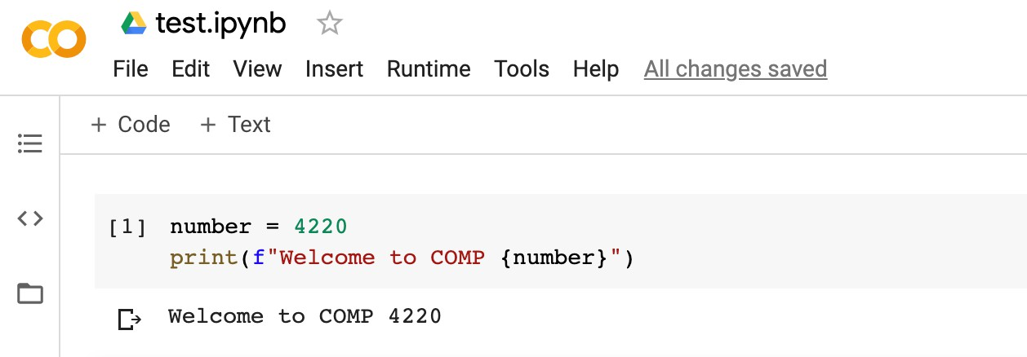
Google Colab
Google Colaboratory, or “Colab” for short, allows you to write and execute Python in your browser
  Zero configuration required
  Free access to GPUs and other computing resources
  Use terminal commands on Google Colab
https://drive.google.com (for the first time, select “Connect more apps”)

Slide 6
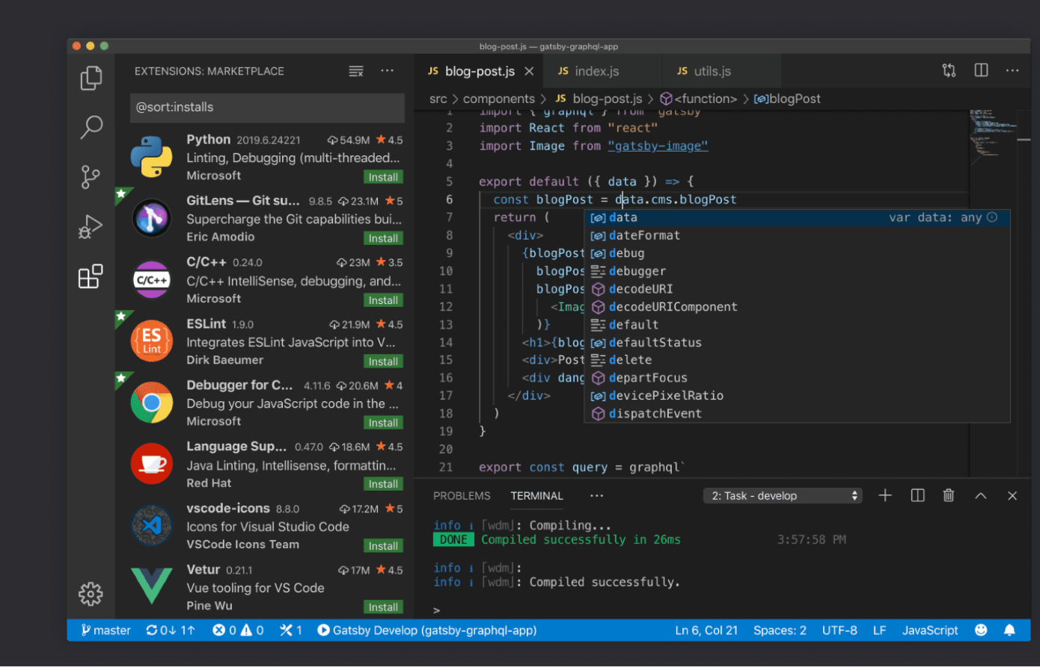
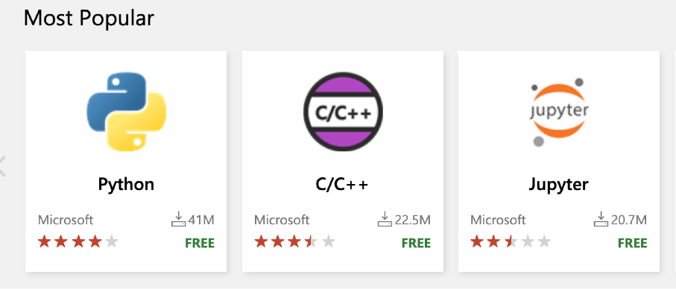
Visual Studi Code
Better alternative for “real” machine learning projects
  https://code.visualstudio.com/

Slide 7
Course structure
Part 1: Fundamentals of Machine Learning (Scikit-Learn)
  Review of Python’s main scientific libraries: NumPy, pandas, and Matplotlib
  Steps in a typical machine learning project
  Learning by fitting a model to data and optimizing a cost function
  Challenges of using machine learning systems
Part 2: Neural Networks and Deep Learning (TensorFlow 2.0, Keras, and PyTorch)
  What neural nets are and what they are good for
  Building and training feedforward neural nets (basics and implementation)
  Convolutional nets for deep computer vision and recurrent neural nets (mainly fundamental concepts)

Slide 8
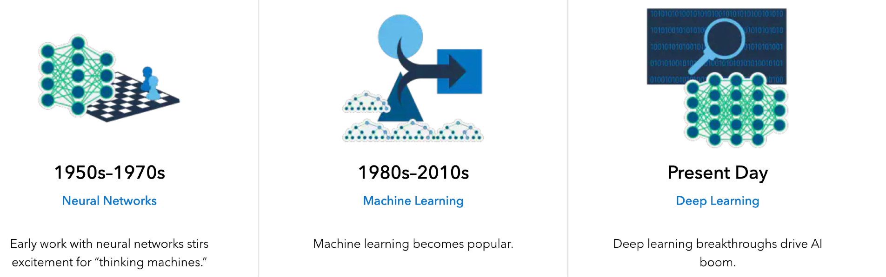
A little bit history
Alan Turing gave quite possibly the earliest public lecture on this topic in 1947:
“What we want is a machine that can learn from experience”

Slide 9
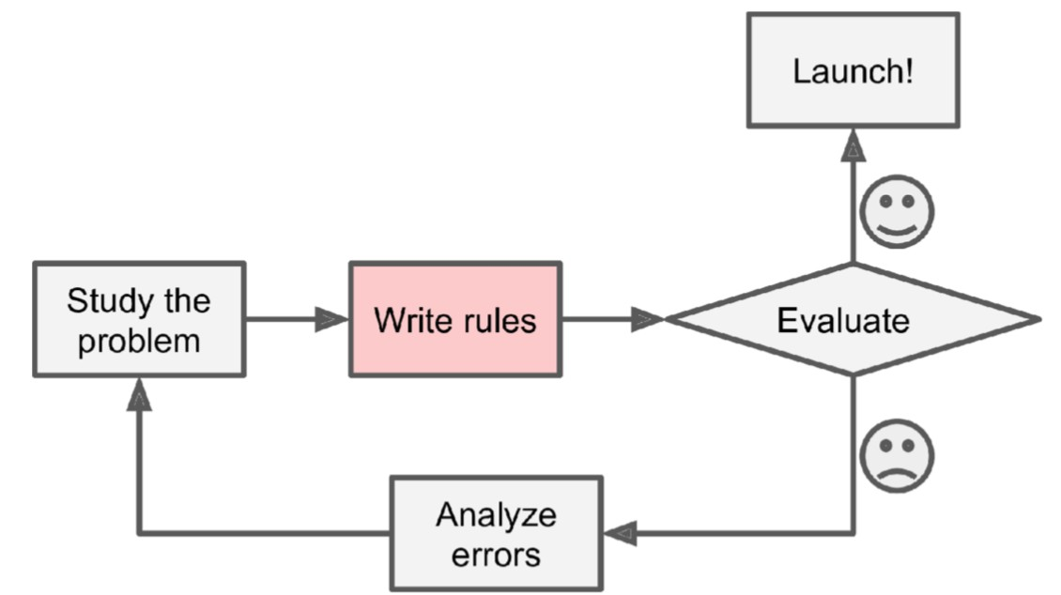
Why should we use machine learning?
Let’s say we want to design a spam filtering system
One approach is to use traditional programming techniques
  Look for words or phrases such as: credit card, free, bank information, “C U”
  Write a detection algorithm for each of the patterns
  Test your program and improve it

Slide 10
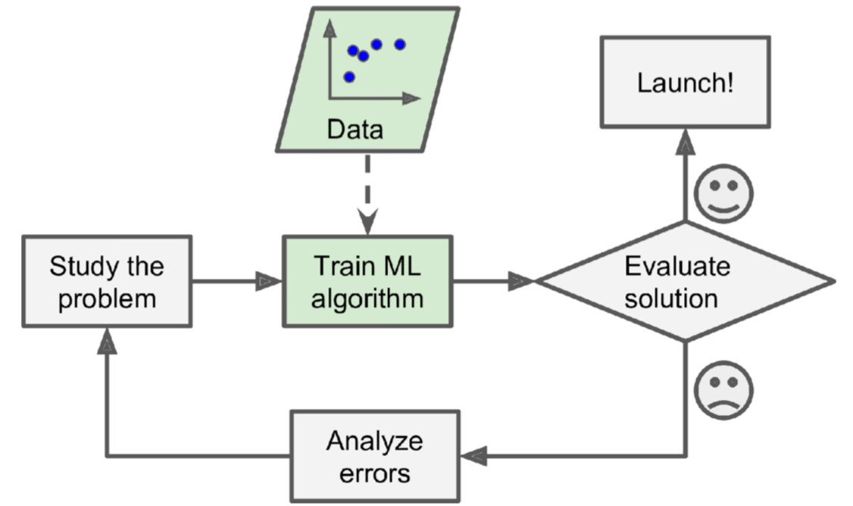
Why use machine learning?
A spam filter based on machine learning automatically learns which words and phrases are good predictors
Possible benefits: simpler, easier to maintain, and more accurate
The examples that the system uses are called the training set
We should also think of a performance measure

Slide 11
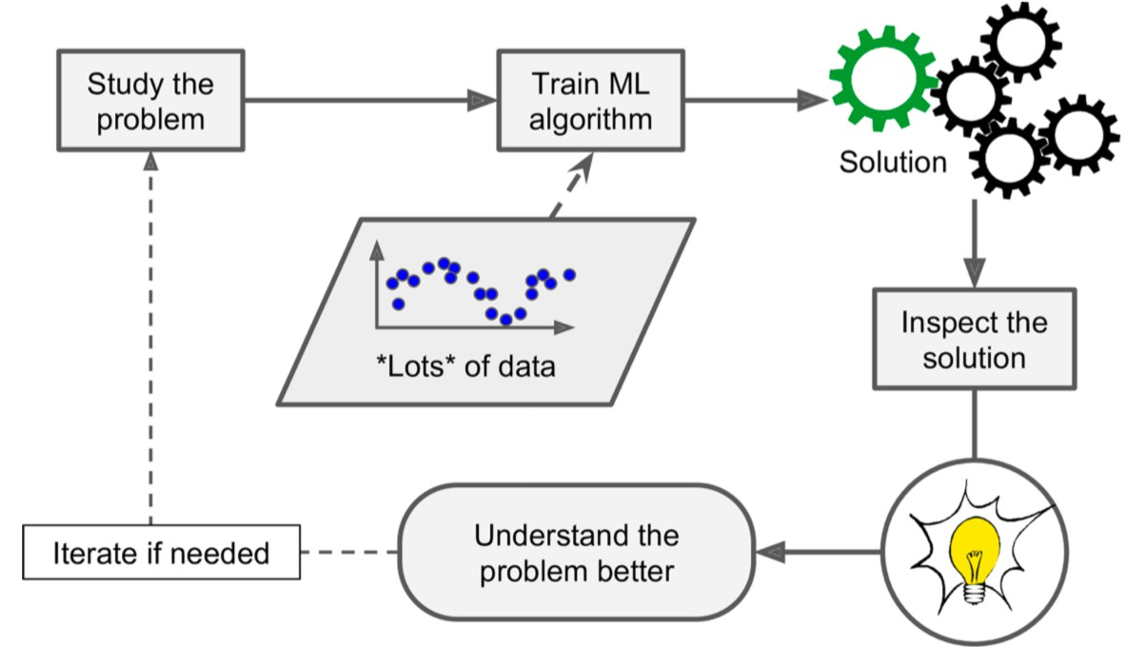
Beyond prediction
Machine learning can help human learn and discover patterns from large amounts of data that are not immediately apparent
This is usually called data mining

Slide 12
A few applications of machine learning
Autonomous navigation systems
Analyzing images of items on a product line
Analyzing medical images
Automatically flagging offensive comments on social media platforms
Forecasting revenue
Creating a recommendation engine
Speech recognition (like Siri and Alexa)
And many more!

Slide 13
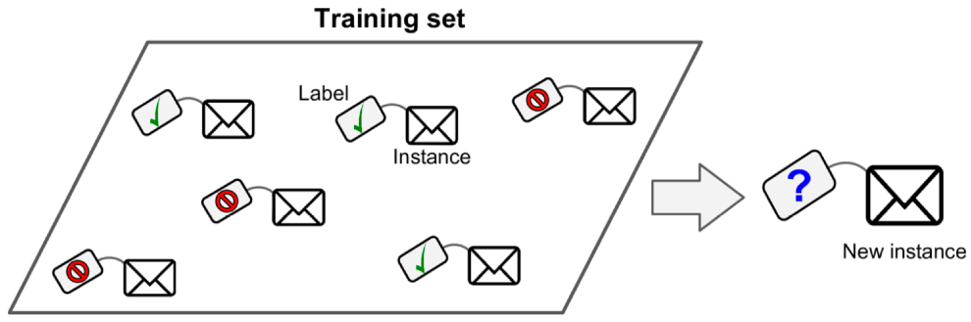
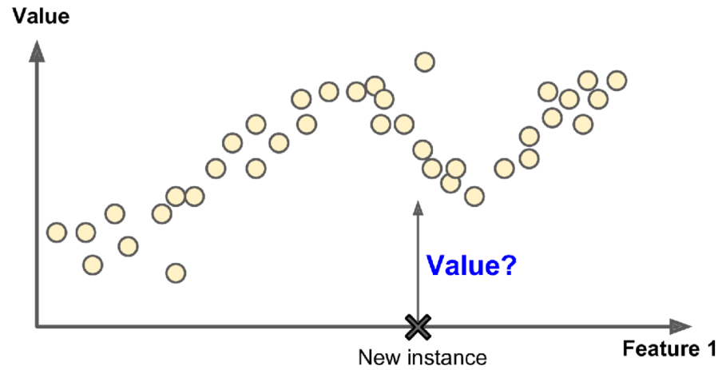
Types of machine learning
ML systems can be classified according to the amount and type of supervision
  Supervised learning: training set includes the desired solutions or labels
    Classification: labels are classes (e.g., spam or ham)
Regression: labels are numeric values (e.g., price of car)

Slide 14
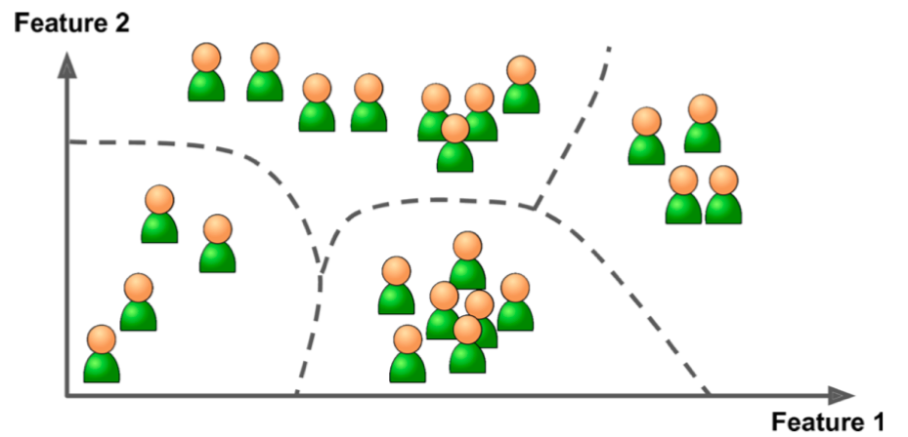
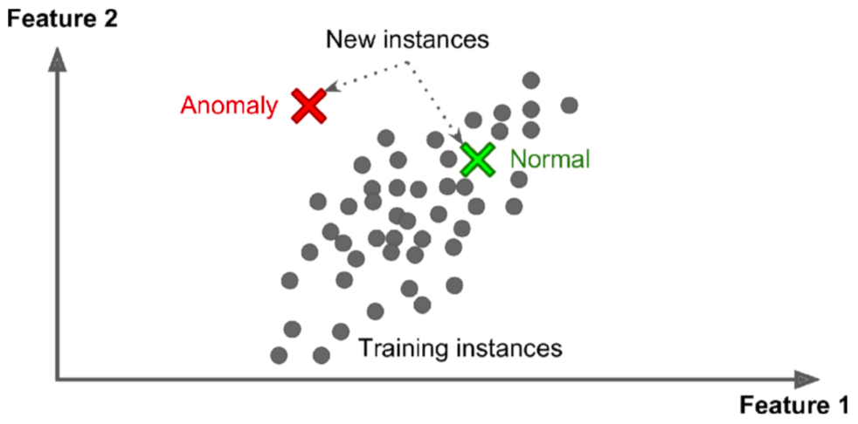
Types of machine learning
Unsupervised learning: ML system tries to learn without a teacher
  For example, based on the shopping history, detect groups of similar visitors
Another example is novelty detection: find new instances that look different

Slide 15
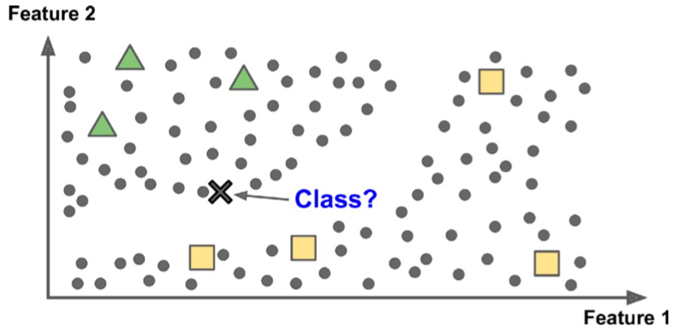
Types of machine learning
Semisupervised learning: plenty of unlabeled instances and few labeled
  Why? Labeling data is costly and time-consuming
  Application: Google Photo
  Tools: Amazon SageMaker Ground Truth
Reinforcement learning: select and perform actions, and get rewards or penalties in return
  Find the best strategy known as policy to get the most reward

Slide 16
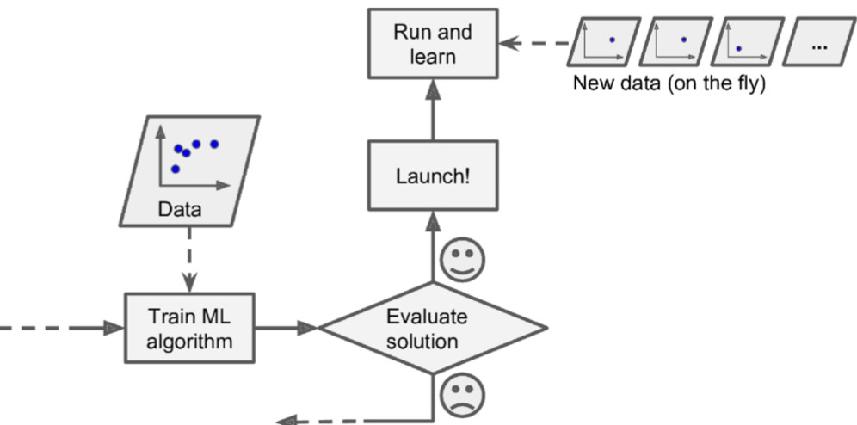
Another categorization
Batch learning or offline learning: the system must be trained using all the available data
  Drawbacks:
    Take a lot of time, computing resources, and storage space
    Not suitable for rapidly changing data
Incremental learning: train the system incrementally by feeding data instances sequentially

Slide 17
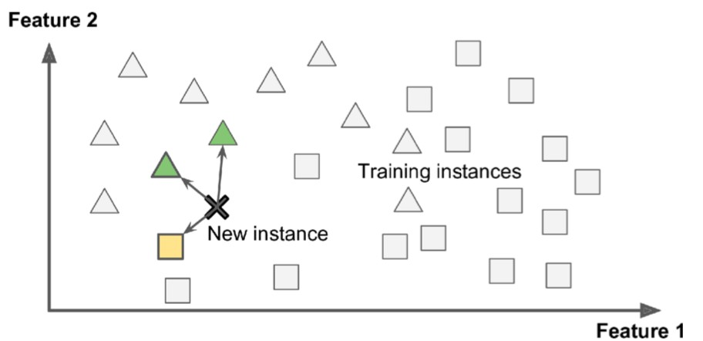
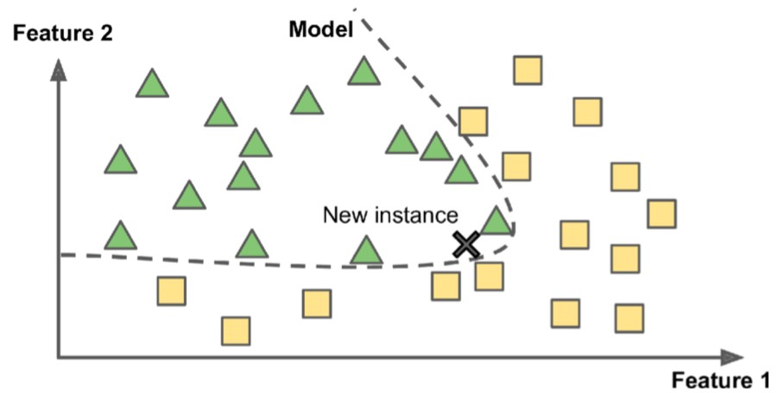
Another categorization
1. Instance-based learning: the system uses a similarity measure to compare new cases to the learned examples
6. Model-based learning: build a model of the learned examples and then use that model to make predictions

Slide 18
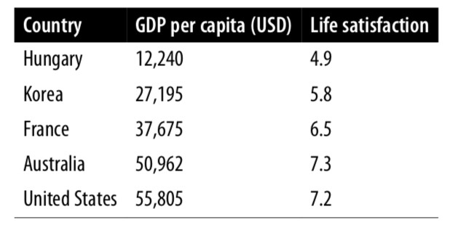
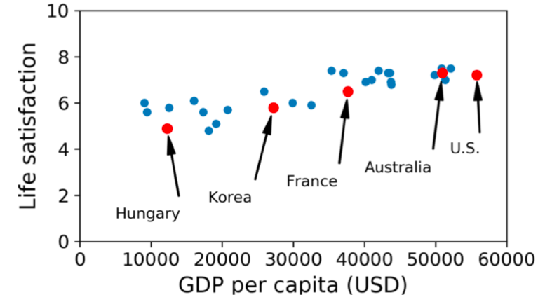
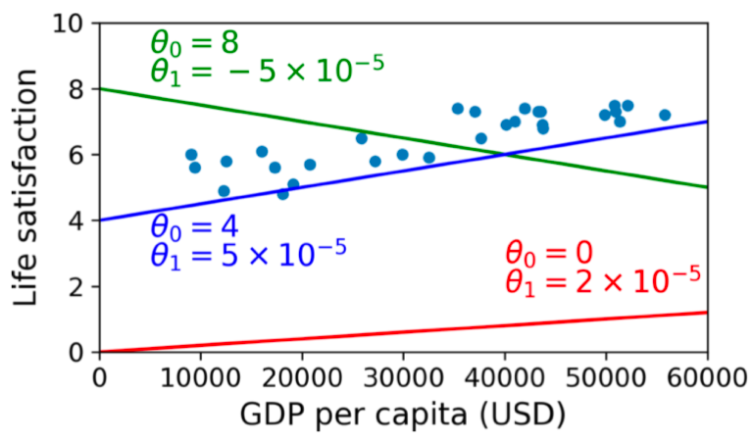
Model-based learning
Does money make people happier?
Let us model life satisfaction as a linear function of GDP
  A simple linear model
Examples

Slide 19
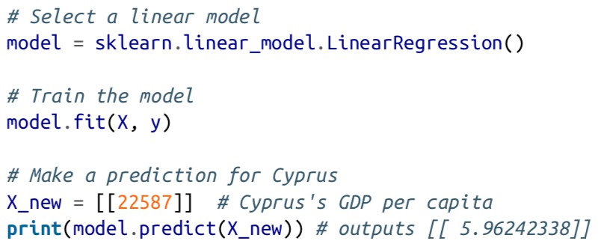
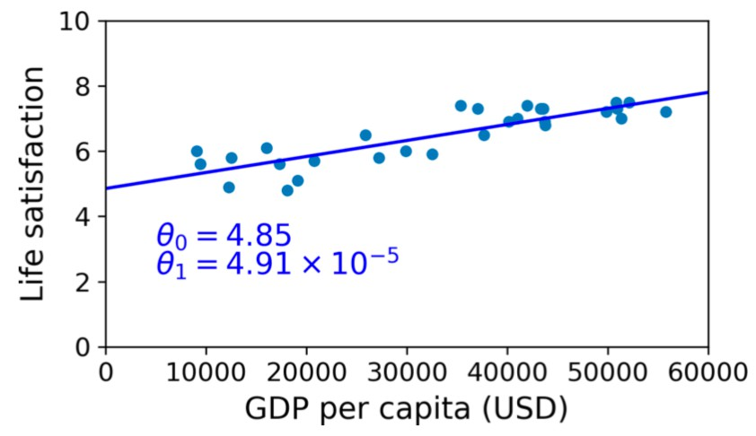
Training a linear model using Scikit-Learn
A few lines of code

Slide 20
Summary of steps
Study the data (data preparation)
Select a model or learning algorithm
Train on the available data and assess performance
Apply the model to make predictions on new cases

Slide 21
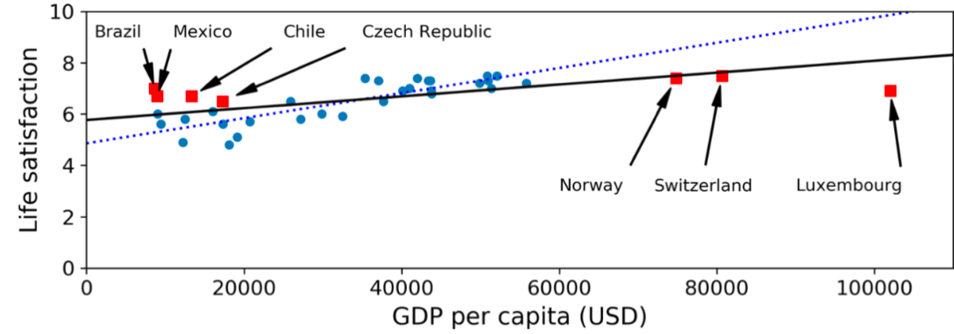
Challenges of machine learning
Insufficient quantity of training data
Non-representative and poor-quality training data
Irrelevant features: coming up with a good set of features

Slide 22
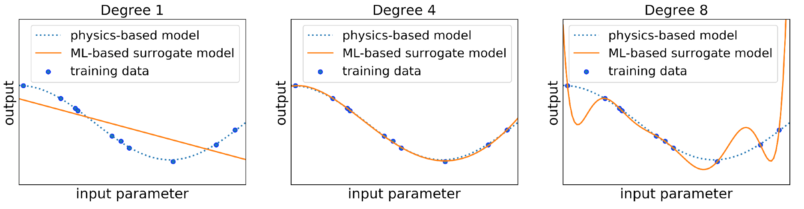
Challenges of machine learning
Overfitting the training data
  When the model is too complex relative to the amount and noisiness of data
How to alleviate this problem?
  Simplify the model
  Gather more training data
  Reduce noise and outliers (i.e., data preparation)

Slide 23
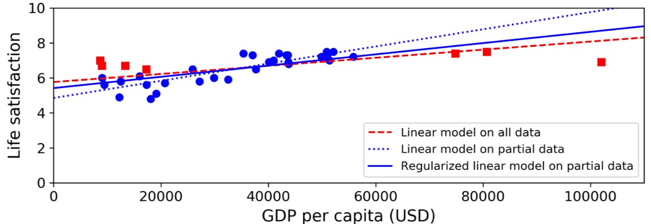
Example of reducing overfitting
Use a subset of data and regularization
  Regularization: balance between fitting the data perfectly and keeping the model simple enough
  Amount of regularization is controlled by a hyperparameter (must be set prior to learning and remains constant during training)
  Tuning hyperparameters is extremely important

Slide 24
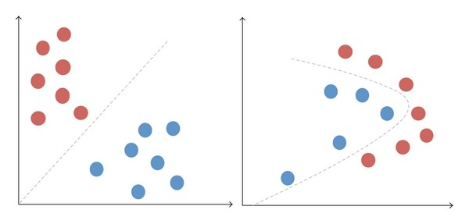
Challenges of machine learning
Machine Learning, Pourkamali
Underfitting the training data
  When the model is too simple
How to solve this problem?
  Select a more powerful model
  Reduce constraints on the model such as regularization

Slide 25
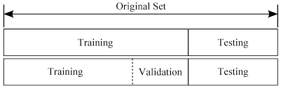
Testing and validation
Machine Learning, Pourkamali
The only way to know how a model will generalize to new cases is to actually try it out on new cases
Split the available data into two sets: training set and testing set
  The error on the test set is called the generalization error or out-of-sample error
  If training error is low and generalization error is high, then overfitting occurs
How to choose suitable models and their hyperparameters?

Slide 26
Basics of Python
https://github.com/farhad-pourkamali/machine-learning

Slide 27
Review of linear algebra and NumPy
Part 1: https://youtu.be/xSO0qOyvevc
Part 2: https://youtu.be/SeBRHg9ZrSs

Slide 28
Introduction
NumPy offers mathematical functions, random number generators, linear algebra routines, and more
  ‘’de-facto” standards of array computing
1D (vector) and 2D arrays (matrix)
a₁ a₂
a
… a
11
1m
a =
∈ ℝ
n
A = ⋮
ªn1
n m
⋮ ∈ ℝ ×
⋮
ªnm
ªn

Slide 29
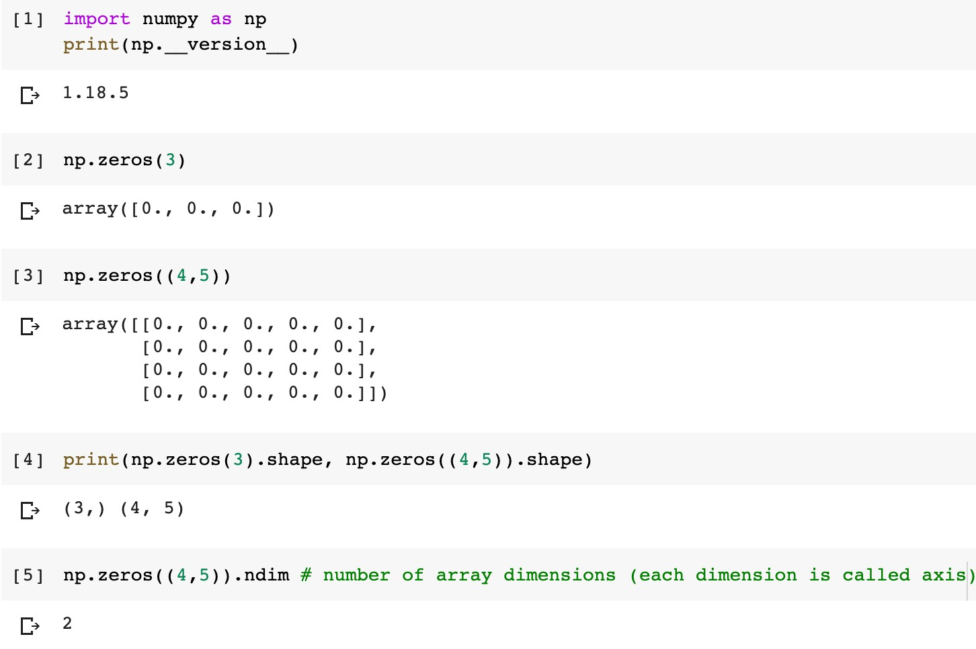
Creating arrays
Notice the difference between 1D and 2D arrays

Slide 30
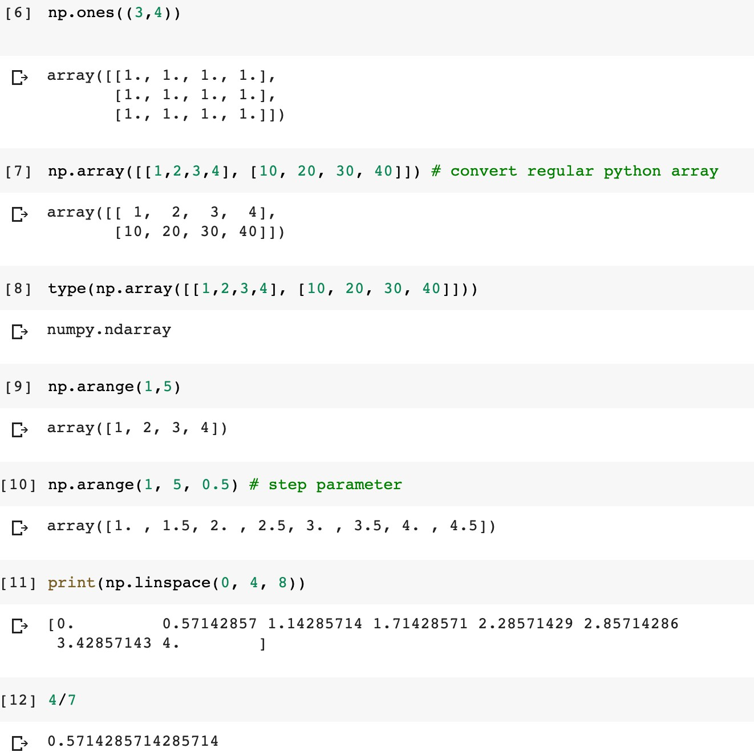
Creating arrays

Slide 31
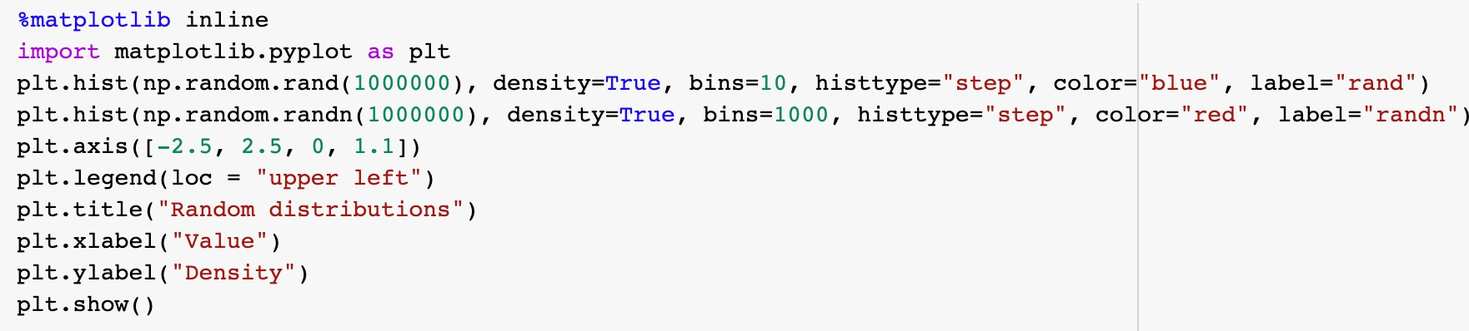
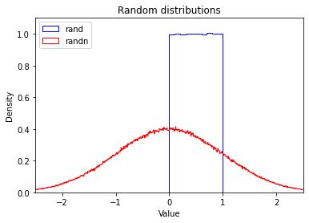
Creating random numbers
Two popular choices are uniform distribution between 0 and 1, and a univariate normal distribution

Slide 32
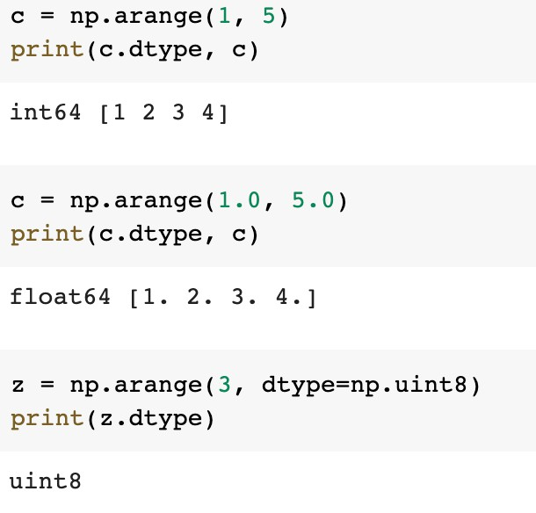
Array data
NumPy’s ndarrays are efficient because their elements must have the same type
  Data types: https://numpy.org/doc/stable/user/basics.types.html

Slide 33
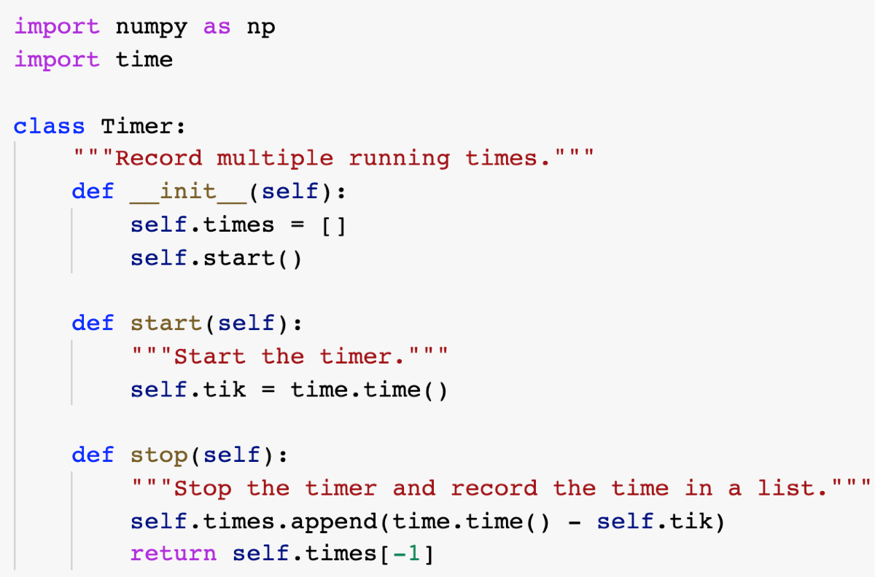
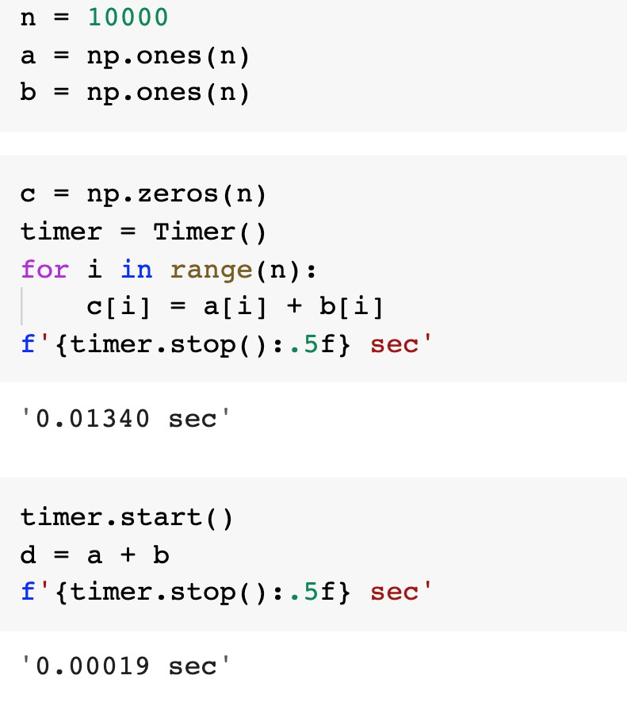
Array data
NumPy’s ndarrays are efficient because their elements must have the same type

Slide 34
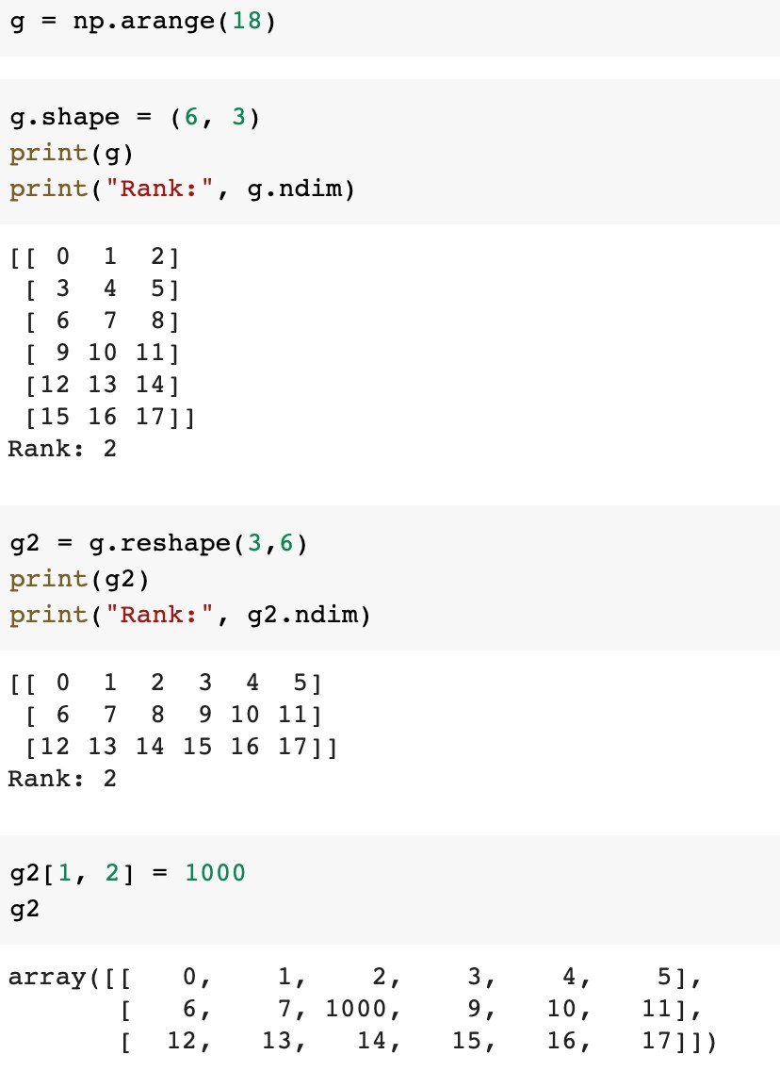
Reshaping an array

Slide 35
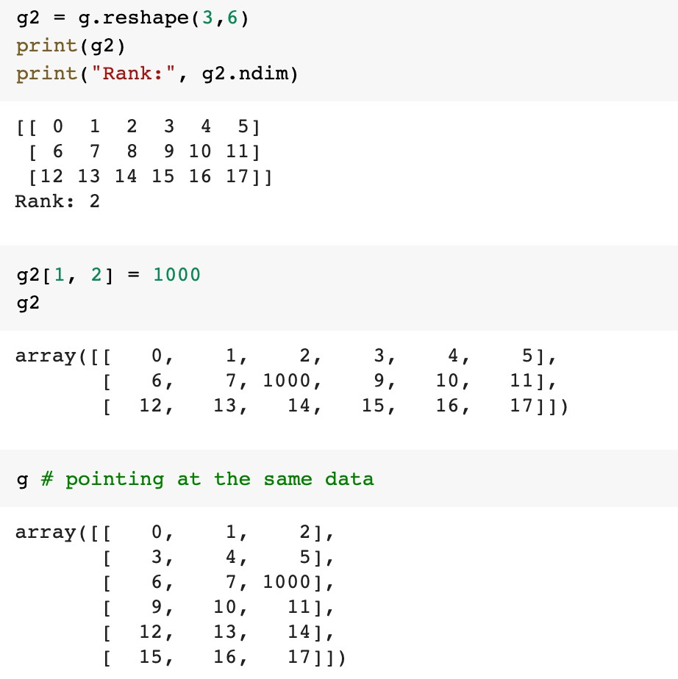
Reshaping an array
The reshape function returns a new array object pointing at the same data.

Slide 36
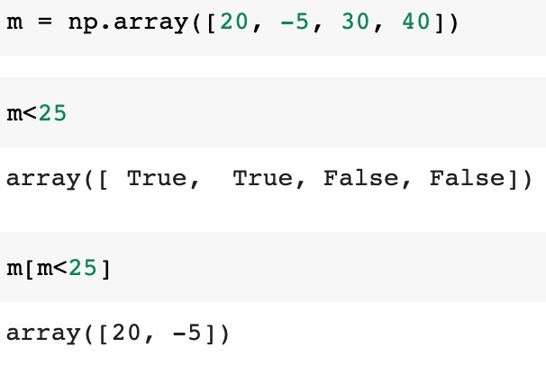
Conditional operators

